Slide 1



O AND M SECTION
322010501009-Rukesh k

Slide 2


contens
Transformers
Puttenahalli Sub-station
Corporate Office

Slide 3
Transformers
Power Transformers
Distrubution Transformers
Power Transformers .
DRY Type
Oil Type

Slide 4
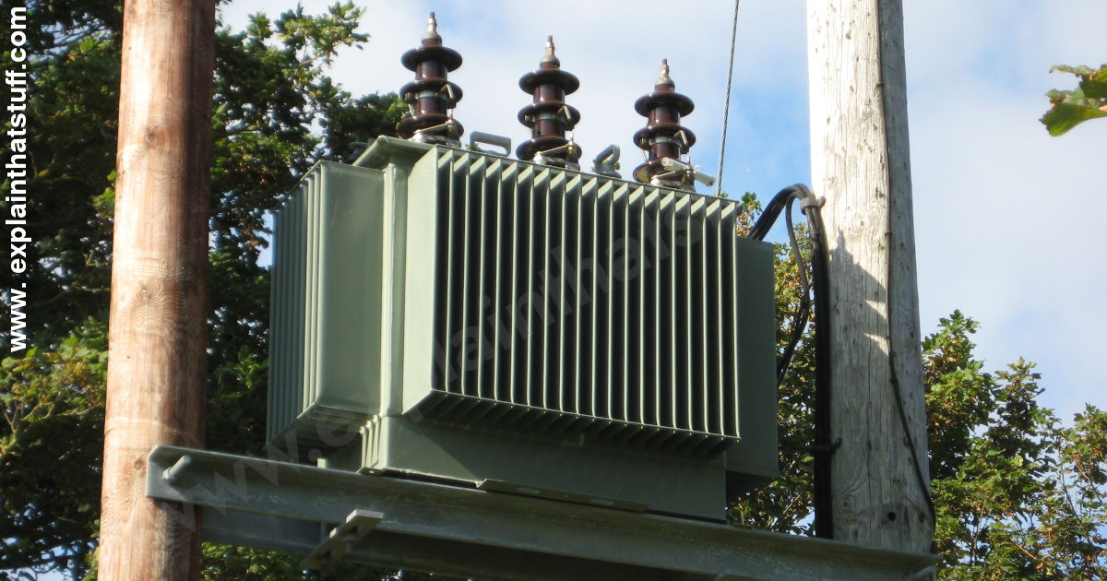
Distrubution Transformers
distribution transformer or service transformer is a transformer that provides the final voltage transformation in the electric power distribution system

Slide 5
Corporate Office
Bangalore Metropolitan Area North Zone
Bangalore Metropolitan Area South Zone
Bangalore Rural Area Zone
Chitradurga Area Zone

Slide 6
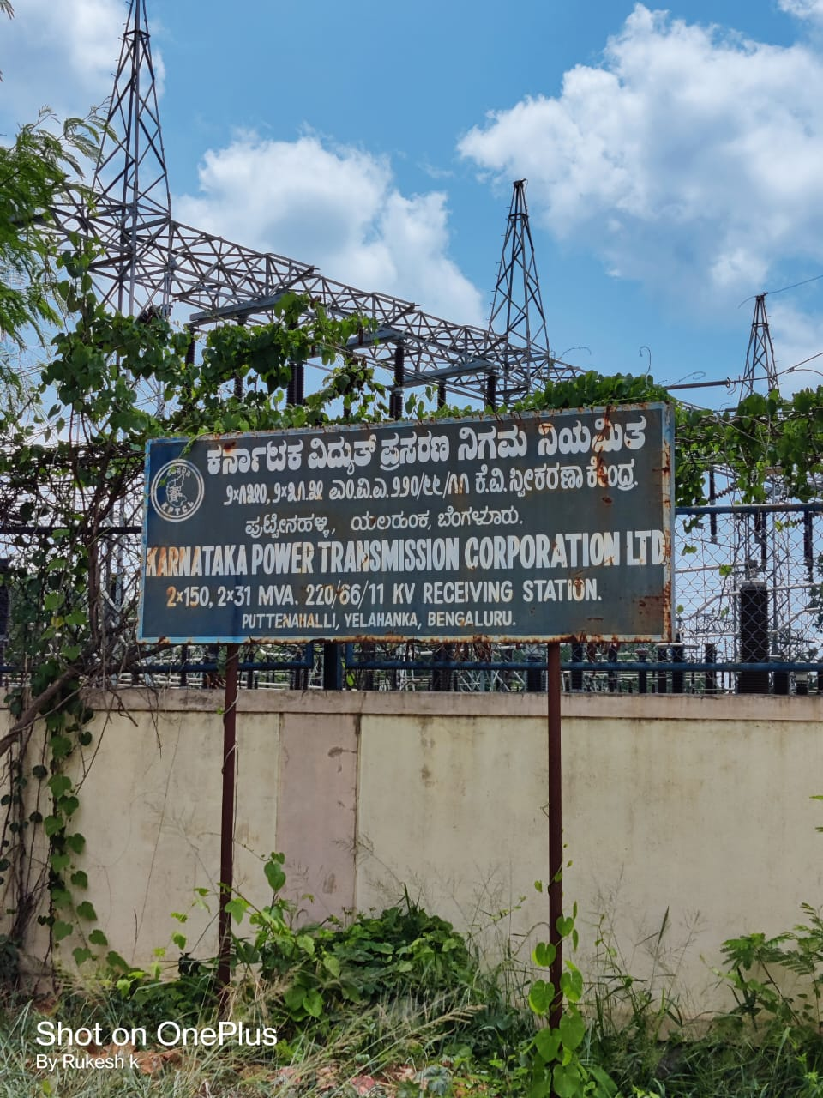
Puttenahalli (kptcl)
220/66/11 kv receiving station.
Step down transform .
There are 18 feeder .

Slide 7
Yelahanka old town feeder
F1-Air force
F5-Yelahanka old town
F6-Maruthi Nagar
F10- Prakruthi Nagar
F12- kogilu
F13- ventala

Slide 8
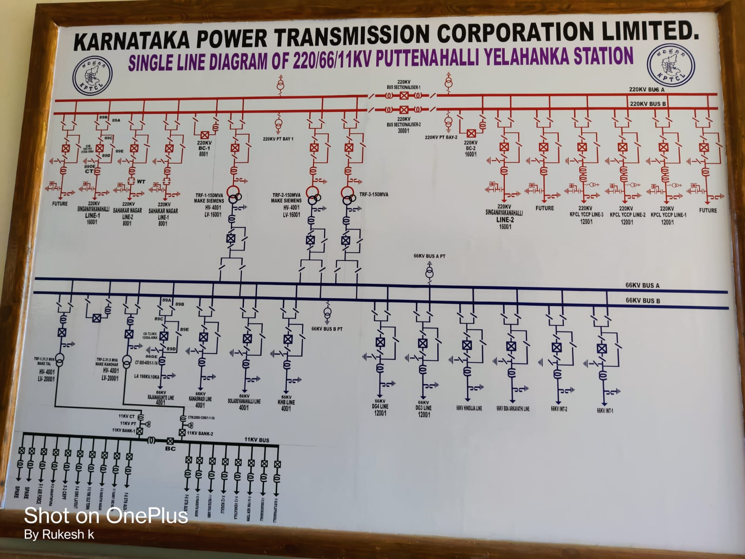
Puttenahalli Sub-station single line diagram

Slide 9
Over head conductor
2 AcsR→ 75 Ams
4 ACSR→ 90 Ams
Rabbit→ 186 Ams most commonly used

Slide 10
Over head line failers
Insulater breaks
Birds
Tree Branches broken
Squrrial birds

Slide 11
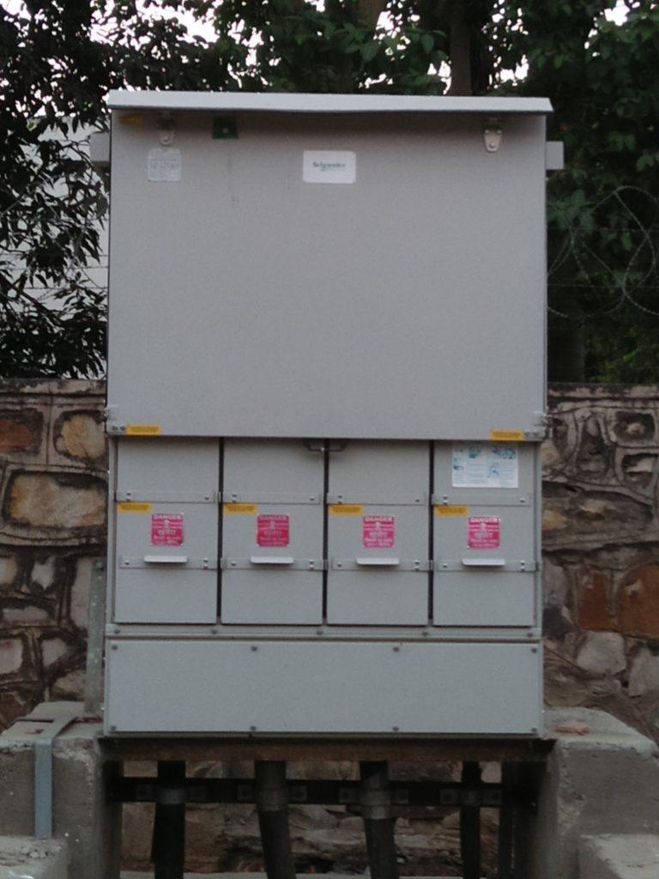
Ug cables
RMU

Slide 12
Ug cables failer
Joint fail
Unknown hitting

Slide 13
Thank you

